Slide 1
Thinking in Sequences
Streams in Node.js & IO.js
Artur Skowroński

Slide 2
Node Streams 101

Slide 3
Source
Pipeline
Sink

Slide 4
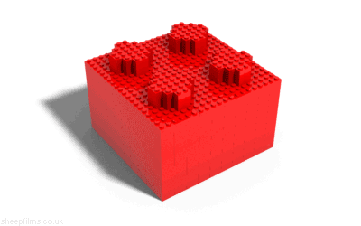

Slide 5
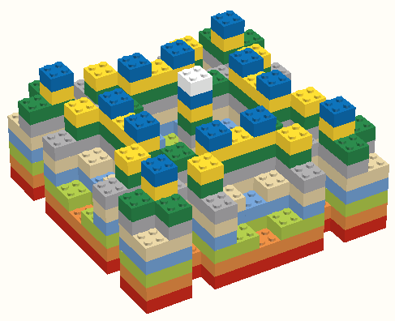

Slide 6

Streams Are Event Emmiters

Slide 7
Transformation 1
Transformation 2
EVENTS:
data
end
Classic Streams Flow

Slide 8
Streams1
Deprecated
Aka. Push Streams

Slide 9
Readable
Writable
Kinds of Streams

Slide 10
request.on('data', function(data){
response.write(transform(data))
});
request.on('end', function(){
response.end()
});
Easiest thing that can possibly work… can it?

Slide 11
Readable Stream
request.pipe(transform).pipe(response)
Writable Stream
Chaining

Slide 12
?
Backpressure?

Slide 13
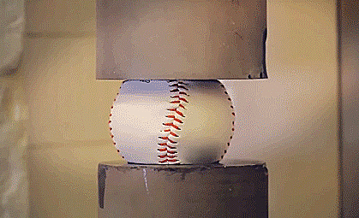
Streams
App

Slide 15
request.on('data', function(data) {
if (response.write(data) == false){
request.pause();
}
});
response.on('drain', function(data) {
request.resume();
});
Readable.resume() & Readable.pause()

Slide 16


Slide 17
Streams2
Aka. Pull Streams
v 0.10

Slide 18
Streams1
Streams2
Readable
Transform
Writable
Duplex
Passthrough
Kinds of Streams

Slide 19
Readable Streams
…strikes back

Slide 20
What ?

Slide 21
fs.createReadStream('file1.txt')
gulp.src('client/templates/*.jade')
Examples

Slide 22
How ?

Slide 23
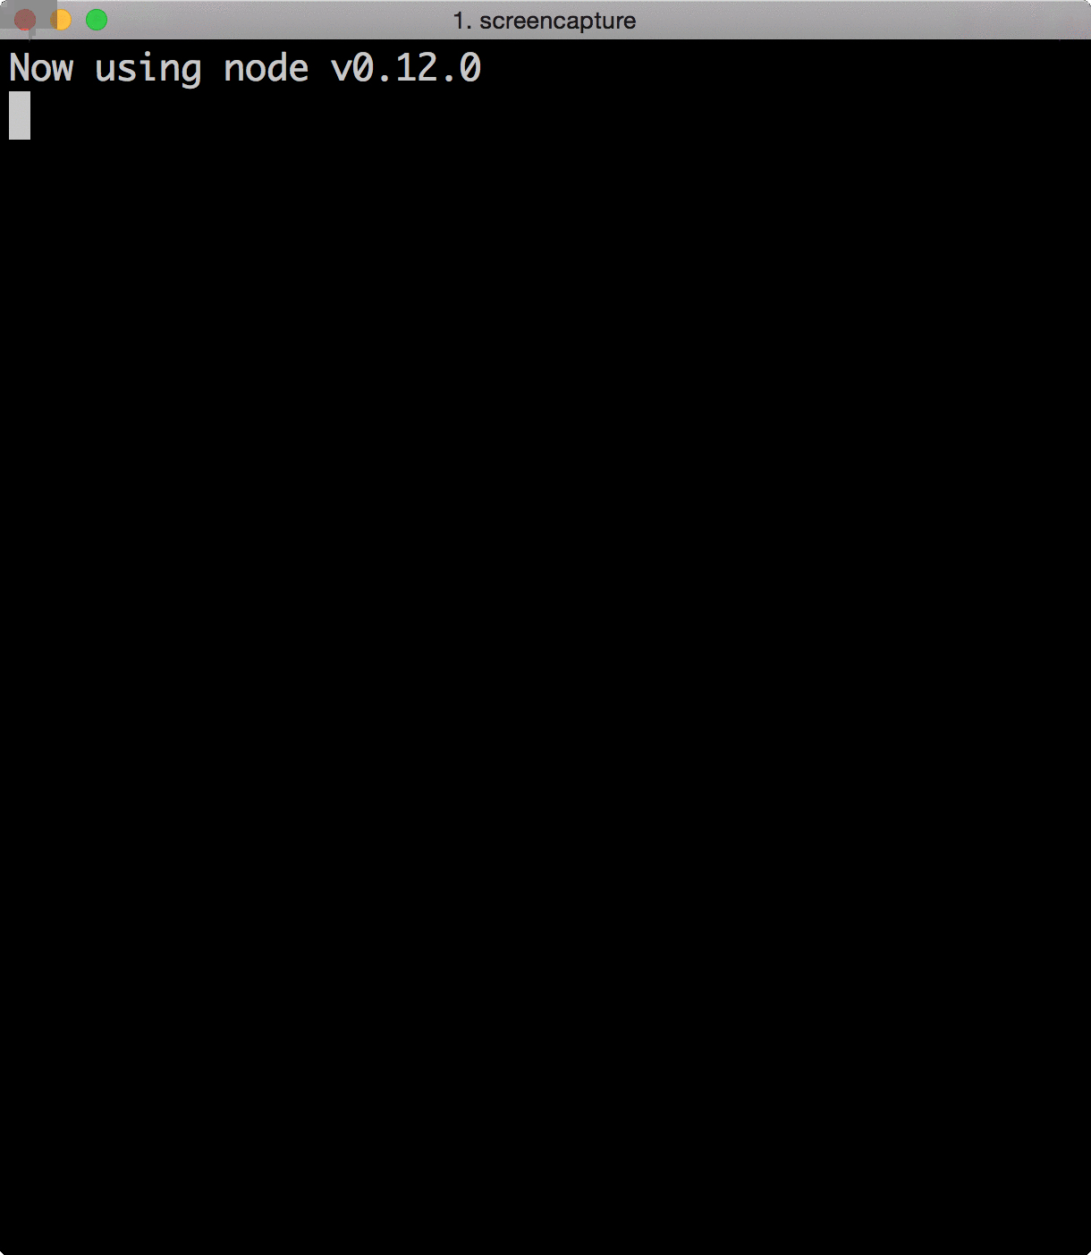
var RStream = require('stream').Readable;
var rs = new RStream;
rs.push('First \n');
rs.push('Second \n');
rs.push('Third \n');
rs.push(null);
rs.pipe(process.stdout);
Example 1

Slide 24


Slide 25
var Readable = require('stream').Readable
util.inherits(RStream, Readable);
var RStream = function (options){
Readable.call(this, options)
}
Subclass stream.Readable

Slide 26
var data = ["First”, "Second”, "Third”];
var curIndex = 0;
RStream.prototype._read = function() {
if (curIndex === data.length)
return this.push(null);
var date = data[curIndex++];
console.log('pushed:' + date);
this.push(date);
Logic Goes There
}
Overwritting _read(size) function

Slide 27
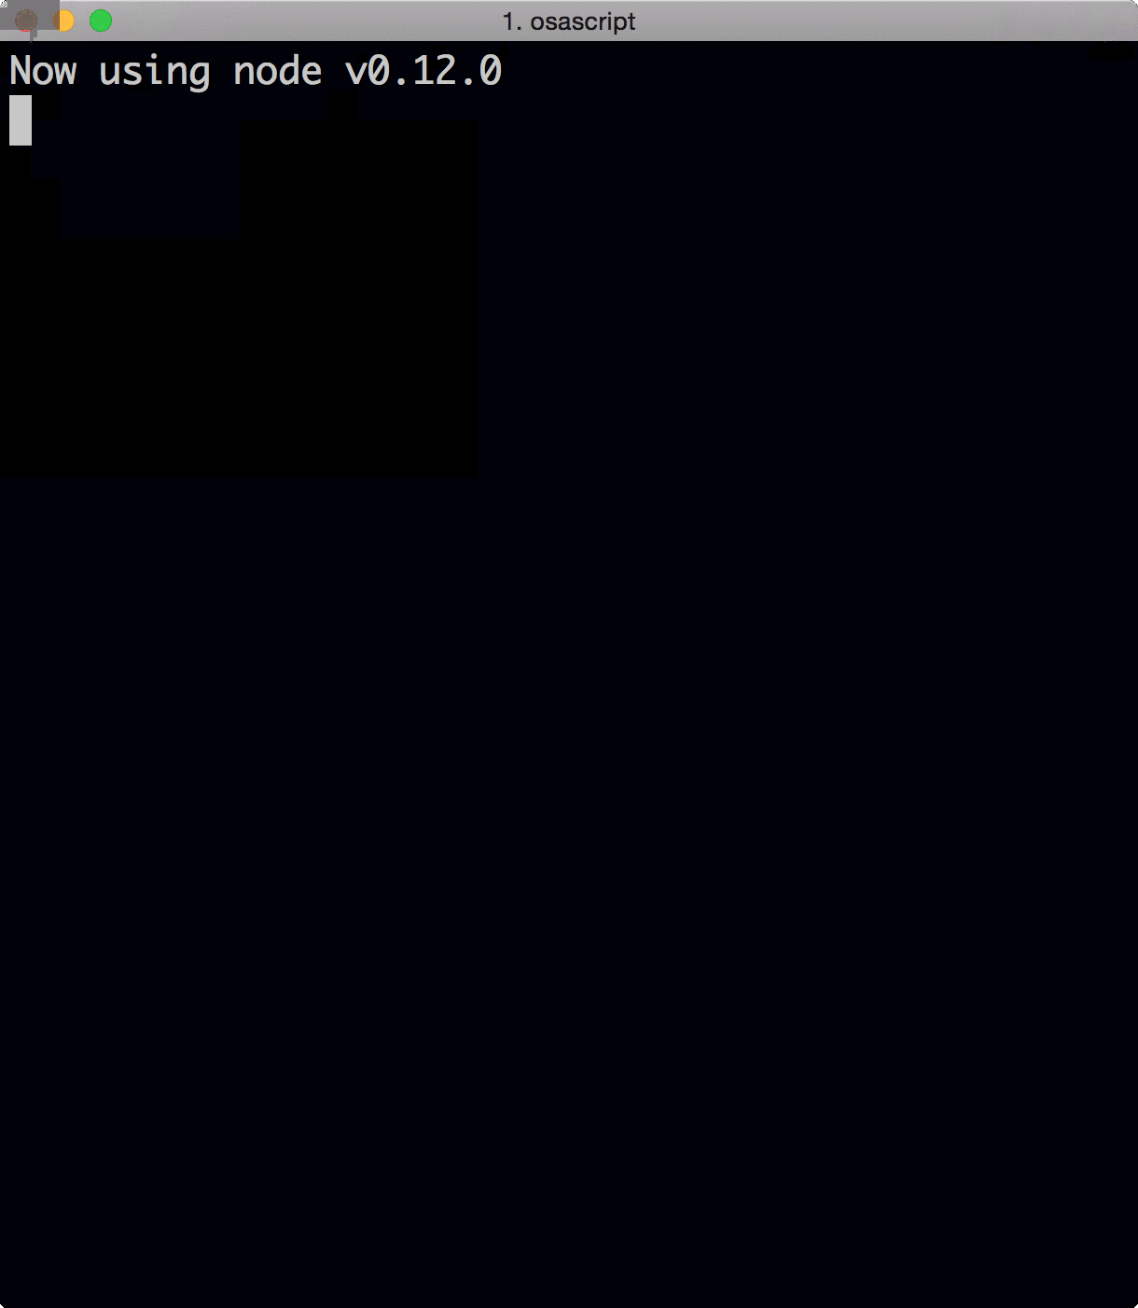
var readFunct = function(el){
log('received:' + el);
}
str.on('data', readFunct);
str.on('end', function() {
log('All consumed');
});
Example 2 – Flowing Mode

Slide 28
var readFunct = function(){
while (null !== (el = str.read())) {
log('received:' + str.read()
}
}
str.on('readable', readFunct);
str.on('end', function() {
log('All consumed');
});
Example 3 – Non-Flowing Mode

Slide 29
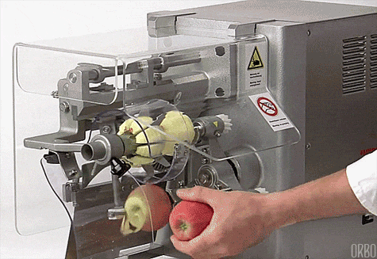

Slide 30
Writable Streams
Streams2 Edition

Slide 31
What ?

Slide 32
fs.createReadStream('file1.txt')
gulp.src('client/templates/*.jade')
Examples

Slide 33
How ?

Slide 34
var WSImpl = function(chunk, encoding, callback) {
console.log('write: ' + JSON.stringify(chunk));
callback();
};
WriteStream.prototype._write = WSImpl
Example 1

Slide 35
var WSImpl = function(chunk, encoding, callback) {
http.request(“foo.bar?p=" + chunk, function(resp){
resp.on(‘end’, callback);
})
};
Example 2

Slide 36
Transform Streams
…I got a power

Slide 37


Slide 38
var TSImpl = function(chunk, encoding, callback) {
console.log('transform : ' + chunk.toUpperCase());
this.push(chunk.toUpperCase());
callback();
};
TransformStream.prototype._transform = TSImpl
How

Slide 39
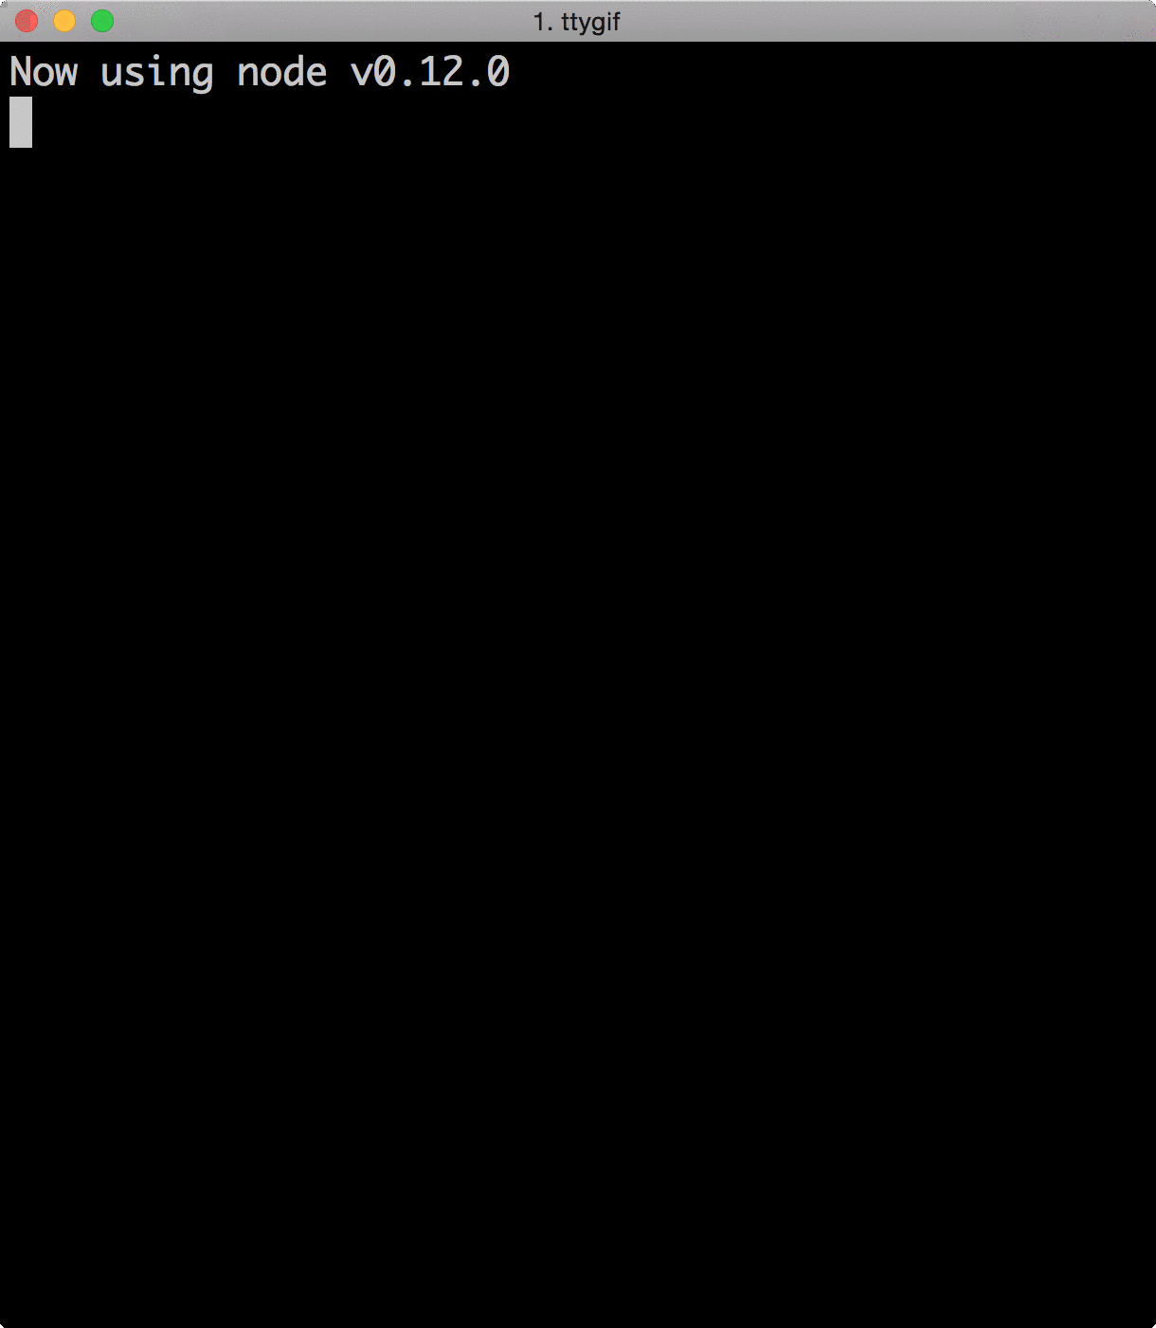
readableStream
.pipe(tranformStream)
.pipe(writableStream)
Example 1

Slide 40
Duplex Streams
God With Two Faces

Slide 41
Passthrough Streams
…because I can

Slide 42

Streams 2

Slide 43
Streams3
Aka. Combined Streams

Slide 44
Pull Push

Slide 45


Slide 46


Slide 47
HIGHLAND
npm install highland
https://github.com/caolan/highland

Slide 48
Node.js Streams Playground
http://nodestreams.com/
Node.js School – Stream Adventure
http://nodeschool.io/
Streams Handbook
https://github.com/substack/stream-handbook
Links

Slide 49
Artur Skowroński
Thank You!
… and waiting for questions!
@ArturSkowronski
arturskowronski.com
github.com/ArturSkowronski
slideshare.net/ArturSkowroski

